Slide 1

RESEARCH SUMMER 2021 WEEKLY REVIEW
Nile Coble Weekly Review

Slide 2
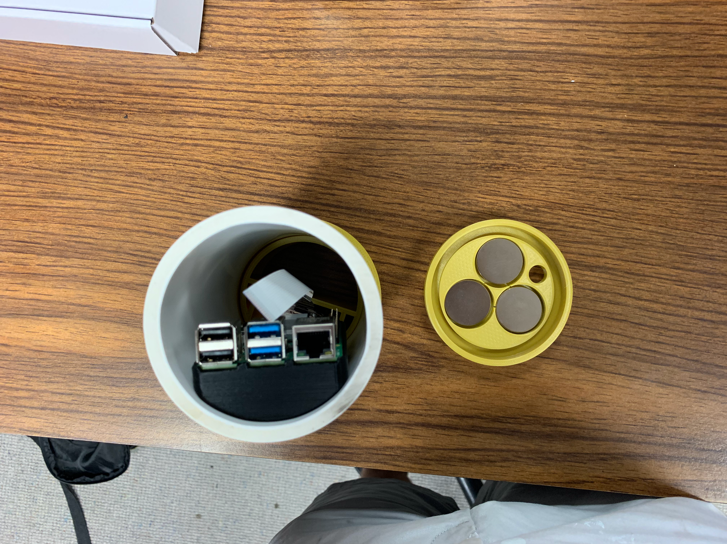
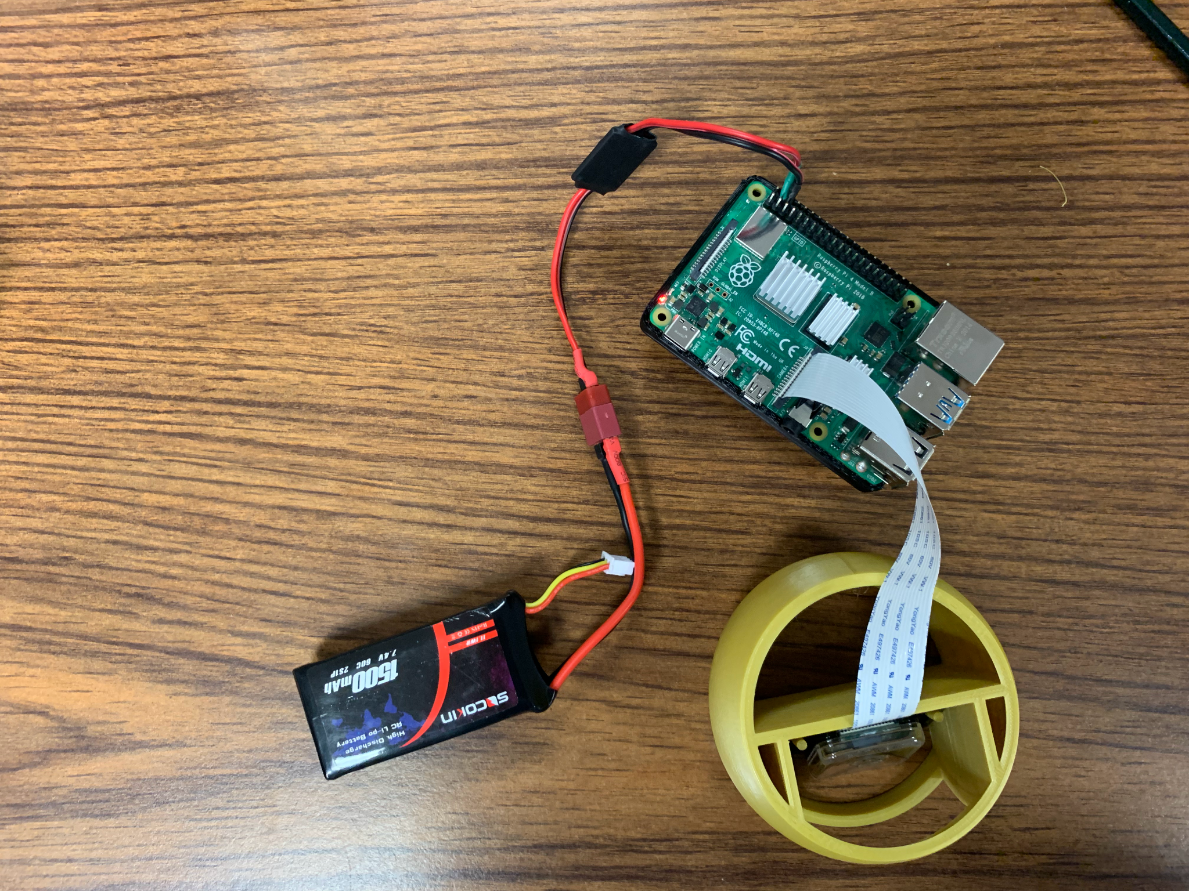
Designed more parts
Now it works off battery power! (Thanks Joud)

Slide 3
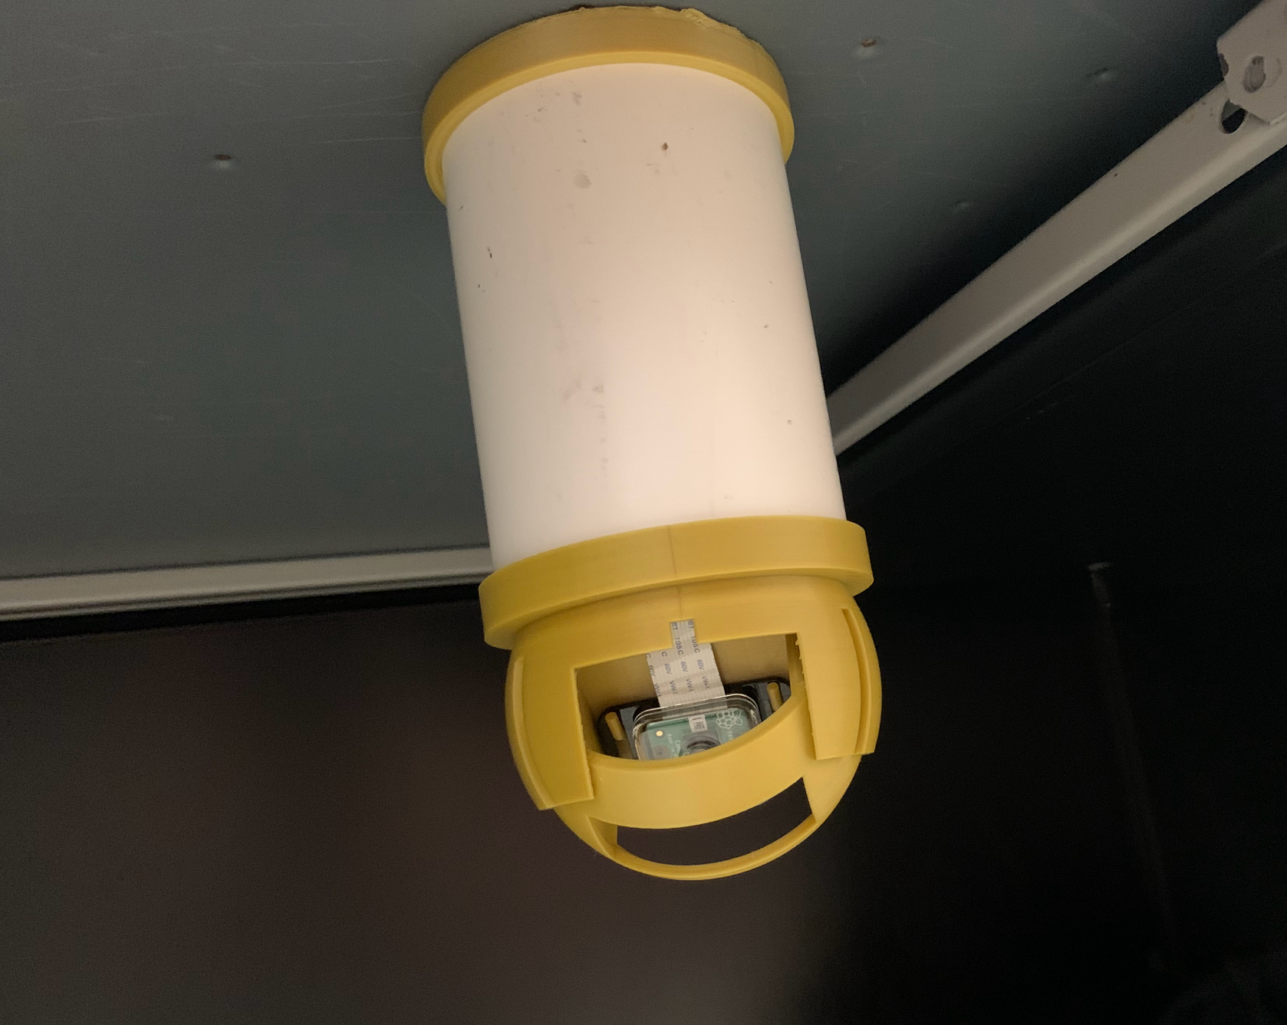
Next Up:
Field distance test
Deployment

Slide 4
THANK YOU

